Slide 1
Damage analyzer PowerApp
Connected Field & Customer Service
Andreas Aschauer

Slide 2
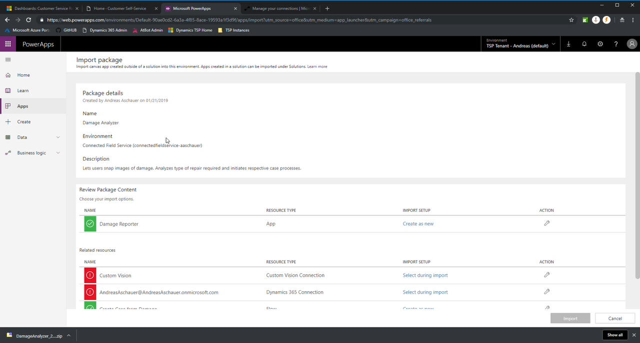
Installation Steps
Navigate to powerapps.Microsoft.com
Click on Apps > Import Package
Select ZIP from Files
Configure Custom Vision Connection
Create a new custom Vision connection
Use 3be2b75070124c48b8b8c2b4aaacda9e as the prediction key
Configure the Dynamics 365 connection as needed
Click Import
Use the provided test image to test image recognition and QR code scanning

Slide 3
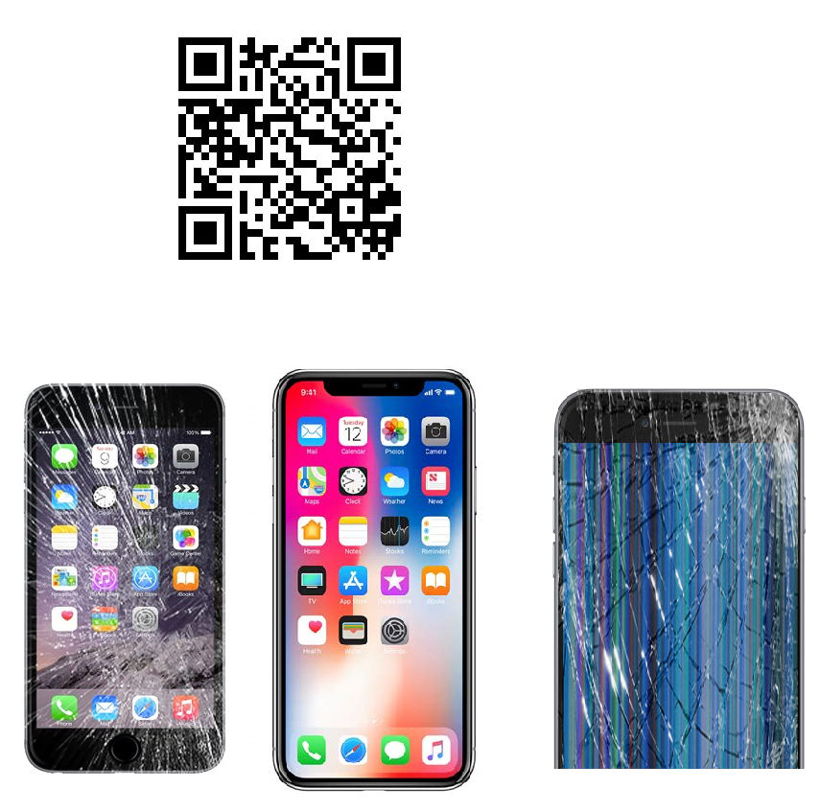
Test image for app

Slide 4

Resources
Fork & Contribute
https://github.com/aschauera/bizappsdev

